Slide 1
SuperPower Vision Group Team Training
Please star this guy QAQ
https://github.com/ganler
Second Training
Image & cv::Mat Memory Layout & Thresholding
Jiawei Liu => jaway.liu@gmail.com
2019/10/07

Slide 2
Today, you’ll learn:
Image quantization.
OpenCV’s default memory layout.
Thresholding.

Slide 3
An Image
/01

Slide 4
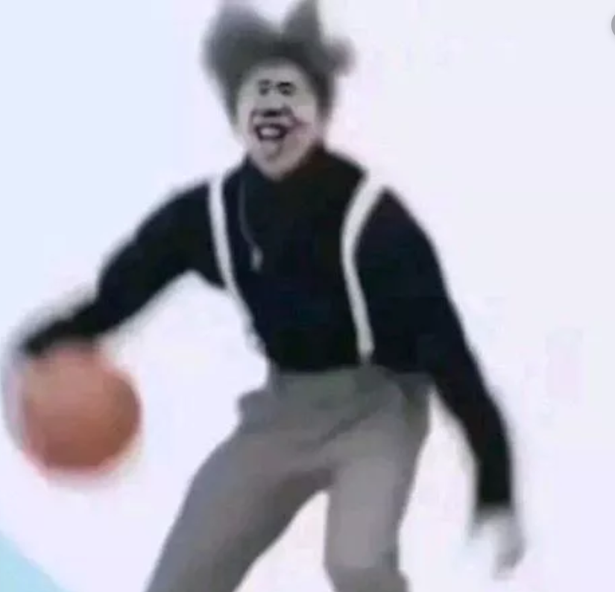
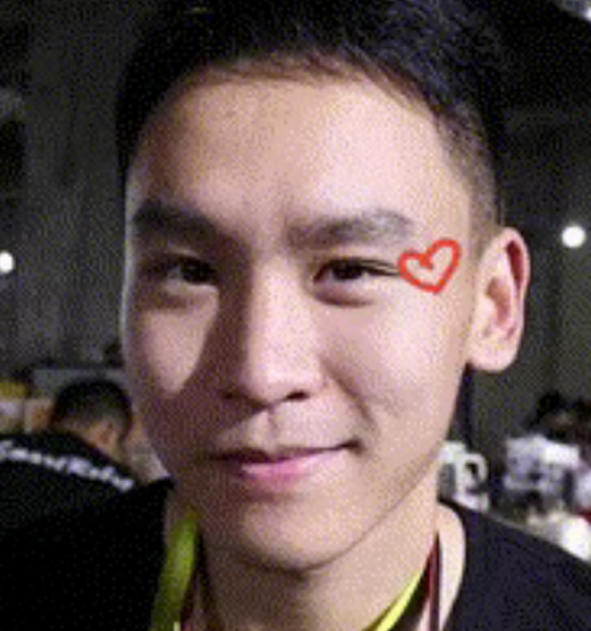
What do u think of an image in an academic way
?
FNMDP.一个图像只是一个函数而已。你说的这种情况是量化后的结果。
我盲猜是一个矩阵，这个
矩阵的每个元素值的范围
是0~255
一位不愿透露姓名的大帅哥
一位不愿透露姓名的科学家

Slide 5


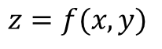
For a 2D image
In real world, what we see is
Where z is the value representing the color of (x, y) .
However the range of z is infinite.
Of course x & y are infinite, as well.
$$z=f(x,y)$$
Memory is not infinite, so we need to quantify them.
Like this…

Slide 6
Quantization.
相关课程：
何良华：图像处理
王翰漓：多媒体技术基础
Infinite z(color) ? => Limited colors
Infinite x&y(space) ? => Limited elements
Traditional approach of Color Quantization:
Use 3 value representing 3 color weights. => (Usually RGB(Red, Green, Blue))
For each value we use only 8 bits(1 byte: 0~255).
(B, G, R )
White => (255, 255, 255)
Black => (0, 0, 0 )
One pixel.
Traditional approach of Space Quantization:
According to your choices.
(width x height)
640 x 480 => 480 p
1280 x 720 => 720 p
1920 x 1080 => 1080p

Slide 7
Default memory Layout of OpenCV
/02

Slide 8
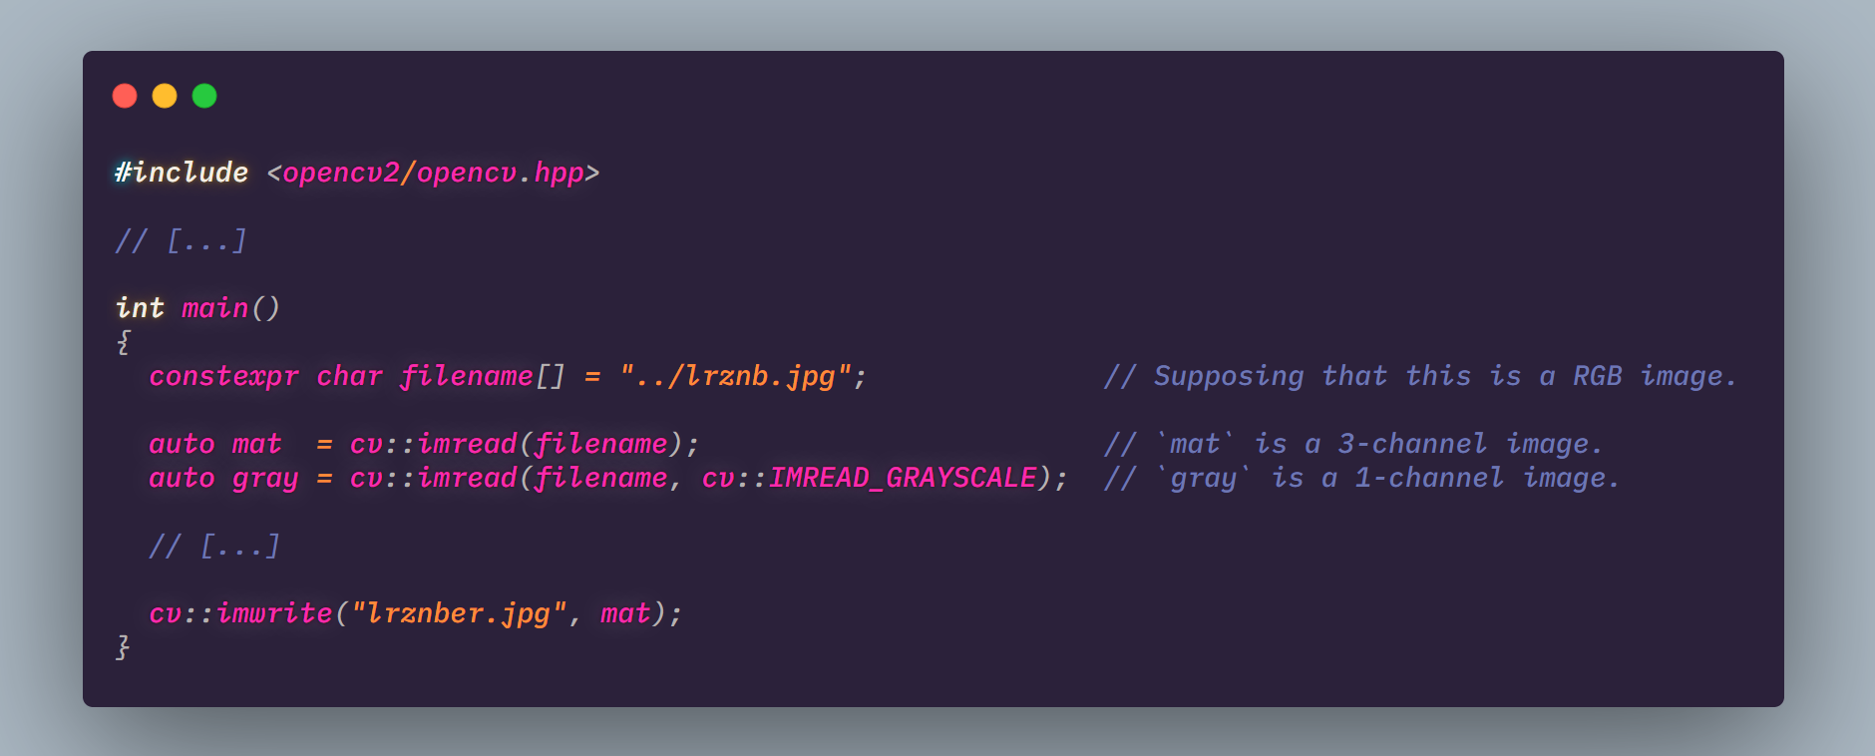
OpenCV IO
cv::Mat
Read in 3-channel by default.
In 1-channel and cvt it to gray.
https://www.ccoderun.ca/programming/doxygen/opencv/classcv_1_1Mat.html

Slide 9
cv::Mat
For image processing: BGR not RGB
(N)WHC:
N => N images
W => Width ~ Column
H => Height ~ Row
C => Channel (i.g. BGR ~ 3 channel)
CPU iteration: by rows(faster)
Continuous by row.
Everything is reference. Want a copy? Call cv::Mat::clone(). But I suggest that u’d better use reference assignment for readability and performance(cv::Mat uses a ref counting technology).
https://docs.opencv.org/3.1.0/d3/d63/classcv_1_1Mat.html

Slide 10
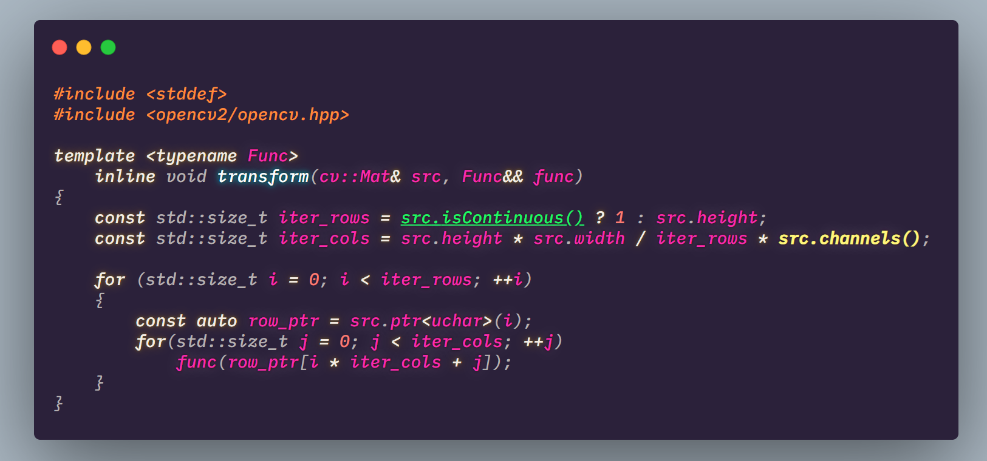
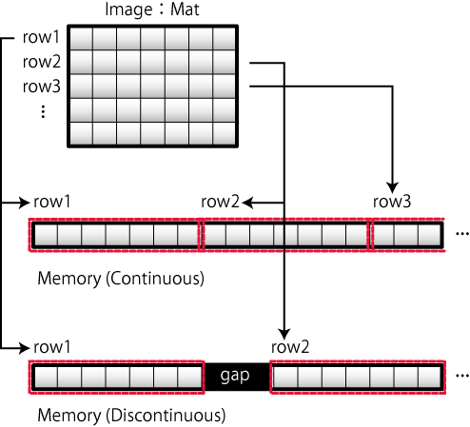
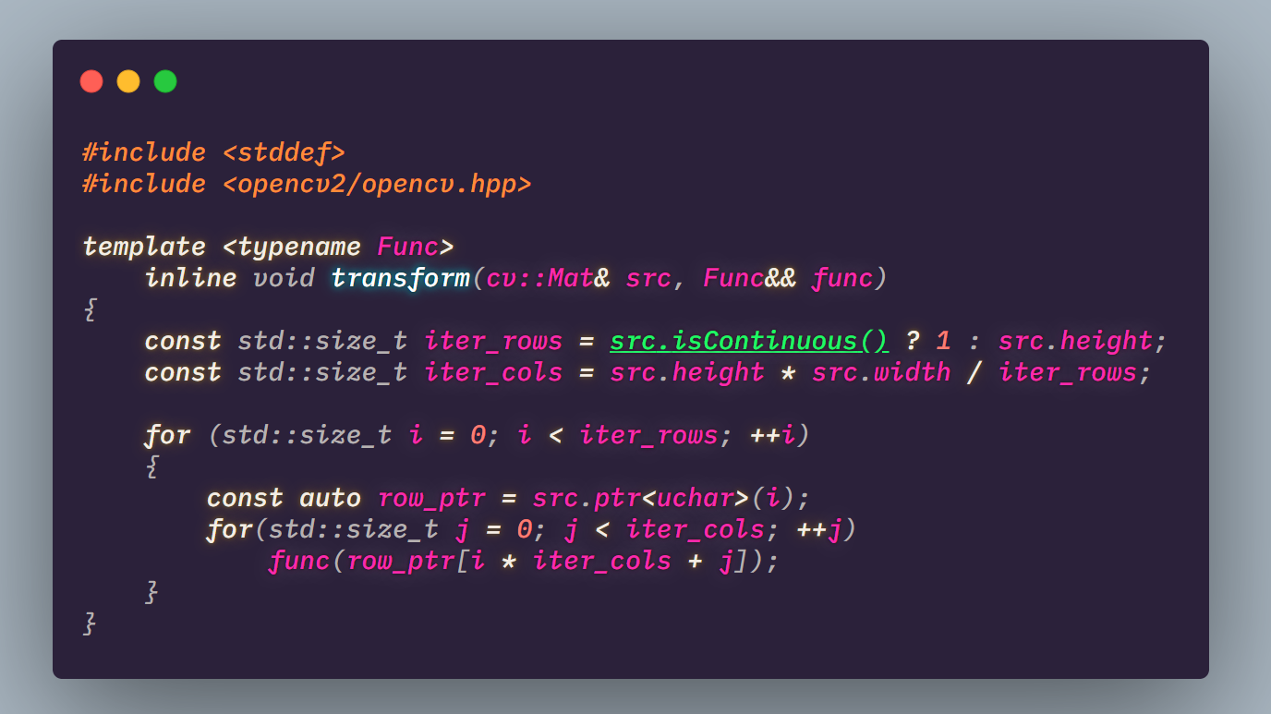
cv::Mat Iteration
Iterate each pixels of a gray image.
And apply func to them.
What about N-channel image iteration ?
http://opencv.jp/cookbook/opencv_mat.html

Slide 11
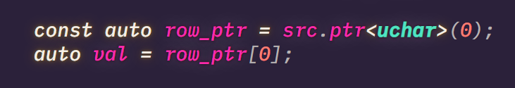
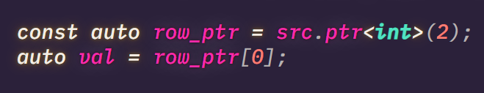
cv::Mat is just a big chunk of memory. What it is depends on how U view it.

Slide 12
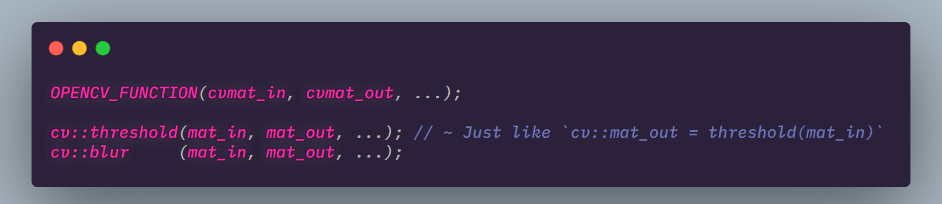
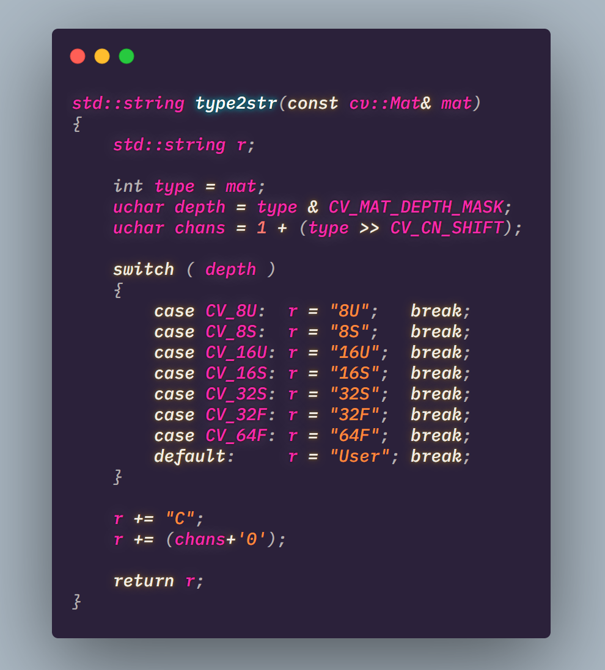
OpenCV function style
Some times U use a function and get a mat_out.
Now U may want to know how should we view this, right?

Slide 13
Thresholding
/03

Slide 14
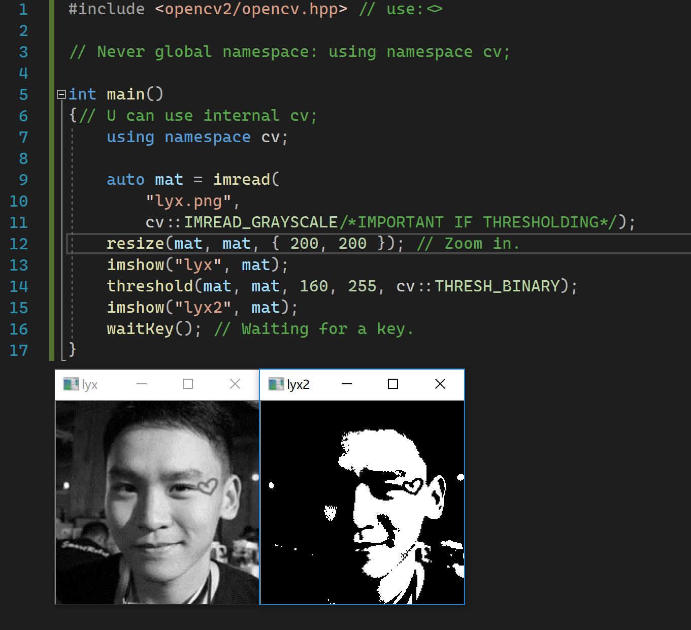
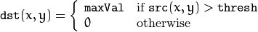
Thresholding using Fixed Value
Convert ur mat to grayscale first!

Slide 15
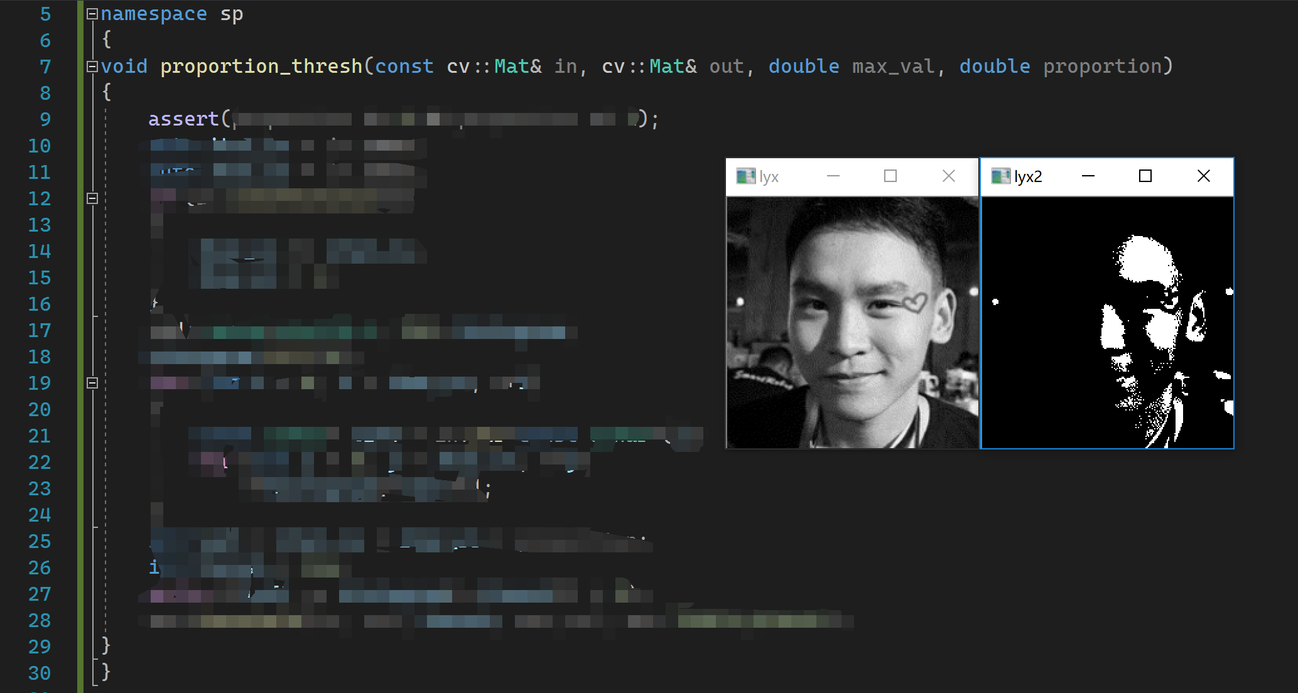
What if we want the most “bright” pixels of a image
This is easy and u can have
this done in 25 lines of code.
i.g. I want the top 40% pixels to be max_val while others are 0.
What should we do?
Fast iteration(in slide 10)
Any optimization if &in == &out?

Slide 16
Today’s LIVE coding
OOD:
Class => timer
Methods =>
timer()
get<time_t>() // Nano-Micro-Milli-Sec
reset()
clk_t:
system_clock
steady_clock
high_resolution_clock
2 clk_t::time_points => (some_cast) => time period

Slide 17
ASSIGNMENTS
[proportion_thresh_test.cpp]Implementation of sp::proportion_thresh()(slide 14) with certain test cases(expecially edge cases).
[center.md]Self learning1:https://www.learnopencv.com/find-center-of-blob-centroid-using-opencv-cpp-python/ (Use markdown written in Chinese/English)
[ROI.md]Self learning2: https://www.learnopencv.com/how-to-select-a-bounding-box-roi-in-opencv-cpp-python/ (Use markdown written in Chinese/English)
DDL
2019/10/13
Notes:
iSlide，让PPT设计简单起来！
iSlide, Make PowerPoint Design Simple!

Slide 18
Things you’d better must know
before next lecture
What is image classification?
Any related algorithm?

Slide 19
std::quick_exit(0);
Notes:
iSlide，让PPT设计简单起来！
iSlide, Make PowerPoint Design Simple!

